Slide 1
CPE 133
NOR & NAND Latches
D Flip-Flops
Registers

Slide 2
Lab Issues
Don’t print provided files
Don’t change generic models (n-bit models)
Override n parameter when instantiated
Don’t forget titles/captions for diagrams
Use courier font only (or equivalent)

Slide 3
Issues
High-level vs. Low-level
Book chapters
80% done
Chapter 20
Long with low-level details

Slide 4
New Terminology: Everything you can do with a bit
Do nothing
Don’t change value
Set it
Make it ‘1’
Clear it
Make it ‘0’
Toggle it (invert it)
If it’s ‘0’, make ‘1’
If it’s ‘1’, make it ‘0’

Slide 5
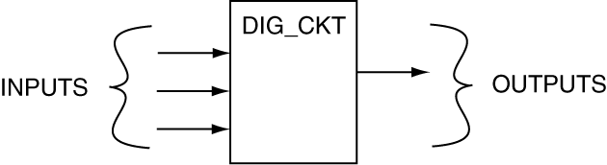
Two Types of Digital Circuits
Combinatorial Circuits:
Outputs a function of circuit inputs
Processes data, but can’t store data (no memory)
Circuits do not have “state”
Sequential Circuits:
Outputs a function of the “sequence” of inputs
Can store data (have memory)
Have “state” (what’s being memorized)

Slide 6
Foundation Modules (thus far): all are combinatorial circuits
RCA
Comparator
Generic Decoder
Parity Generator
Standard Decoder
4:1 MUX

Slide 7
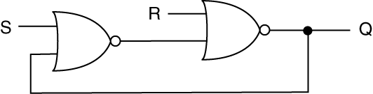
A New Circuit?

Slide 8
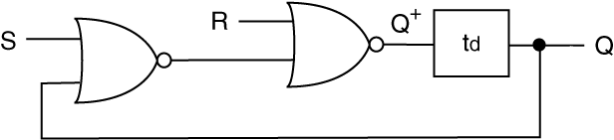
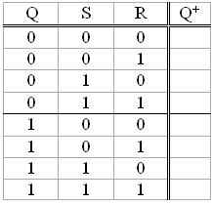
A Seemingly Simple Circuit
td = lumped delay

Slide 9
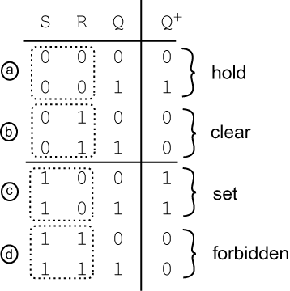
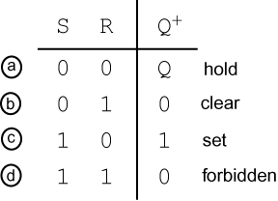
Results of Analysis
Full Truth Table
Compressed Truth Table

Slide 10
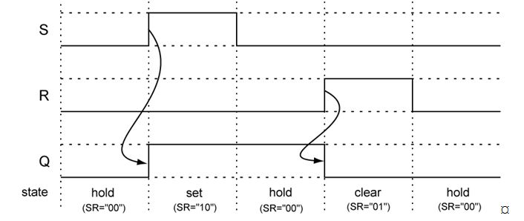
Timing Diagram
Significance: circuit can remember one bit
“State”: the value of the bit being remembered

Slide 11
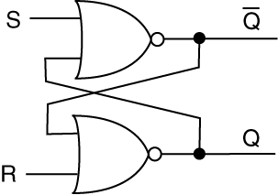
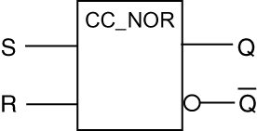
NOR Latch Models: One Bit Memory
AKA:
Cross Coupled Cell
Cross Coupled NOR Cell
NOR Latch
Latch

Slide 12
State Diagrams
Common way of modeling sequential circuits
Shows “important” states of circuit
What we’ll be doing for remainder of course
Draw state diagram for NOR latch

Slide 13
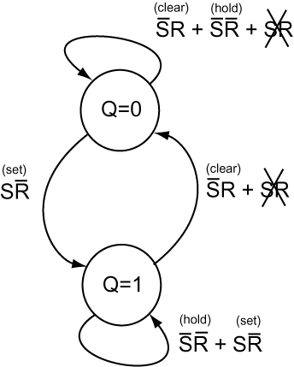
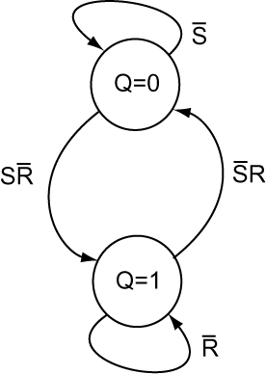
State Diagrams

Slide 14
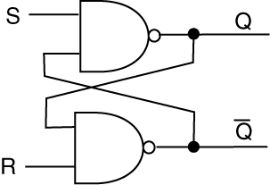
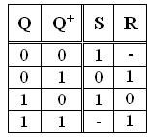
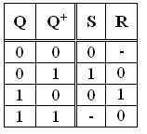
NAND & NOR Latches
NAND Latch
NOR Latch
Circuit Form
Block Diagram
Excitation Tables

Slide 15
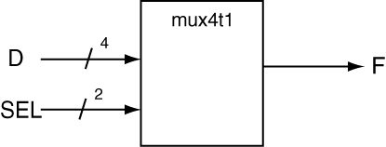
Verilog MUX Models
module mux_4t1_a(SEL, D, F);
input [1:0] SEL;
input [3:0] D;
output reg F;
always @(SEL, D)
begin
if (SEL == 0) F = D[0];
else if (SEL == 1) F = D[1];
else if (SEL == 2) F = D[2];
else if (SEL == 3) F = D[3];
else F = 0;
end
endmodule
module mux_4t1_a(SEL, D, F);
input [1:0] SEL;
input [3:0] D;
output reg F;
always @(SEL, D)
begin
if (SEL == 0) F = D[0];
else if (SEL == 1) F = D[1];
else if (SEL == 2) F = D[2];
else if (SEL == 3) F = D[3];
end
endmodule
What’s the difference?

Slide 16
Verilog MUX Models
module mux_4t1_a(SEL, D, F);
input [1:0] SEL;
input [3:0] D;
output reg F;
always @(SEL, D)
begin
if (SEL == 0) F = D[0];
else if (SEL == 1) F = D[1];
else if (SEL == 2) F = D[2];
else if (SEL == 3) F = D[3];
else F = 0;
end
endmodule
module mux_4t1_a(SEL, D, F);
input [1:0] SEL;
input [3:0] D;
output reg F;
always @(SEL, D)
begin
if (SEL == 0) F = D[0];
else if (SEL == 1) F = D[1];
else if (SEL == 2) F = D[2];
else if (SEL == 3) F = D[3];
end
endmodule
If you don’t include a catchall, the synthesizer generates a latch!
Your circuit is “bigger” than it needs to be and probably wont’ work properly

Slide 17
Flip-Flops
Flip-flop: one-bit storage element
Flip-flop flavors
D Flip-flop (T Flip-flop, JK Flip-flop)
Sensitivity: when the output can change
Latch: level-sensitive 1-bit storage element
Output changes any time inputs change
Asynchronous circuit
Flip-flop: edge sensitive 1-bit storage element
Output can only change on “clock edge”
Synchronous circuit

Slide 18
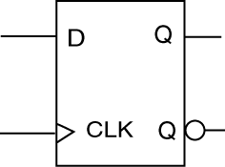
D Flip-flop
Synchronous circuit
Has clock input
Output changes are synchronized to active clock edge
“Edge Trigger”
Rising edge (RET)
Falling edge (FET)
Internal circuitry: very complicated
We model at higher-level
Features
“data” input
clock input
complementary outputs

Slide 19
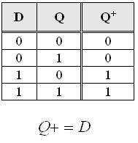
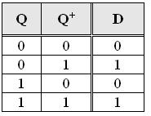
D Flip-flop
Block Diagram
Excitation Table
Characteristic Equation
D flip-flop: “Data” flip-flop
The D input of the flip-flop appears on the Q output when the active clock edge occurs
Generate state diagram

Slide 20
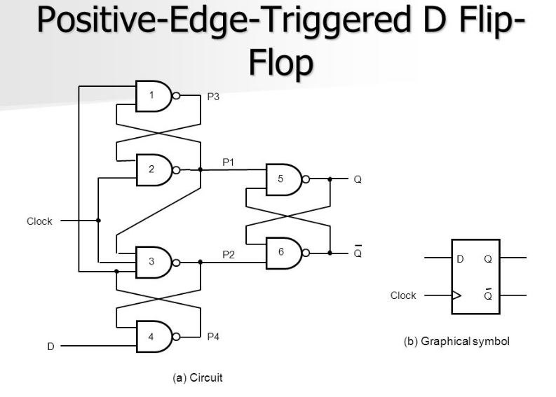
D Flip-flop Low-Level Details

Slide 21
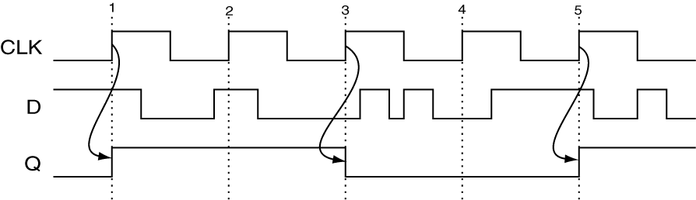
D Flip-flop Timing Diagram

Slide 22
Summary of Important Stuff
Digital circuit types
Combinatorial (no memory, no state)
Sequential (memory & state)
1-bit storage elements
Latch (level sensitive)
NOR & NAND latches
D flip-flop (edge sensitive)
Latch vernacular
Noun: a 1-bit storage element (or storage elements)
Verb: to store data in a memory element
Verilog
Use catchalls to avoid latches in combinatorial circuits

